Slide 1


Comparative Machine Learning Framework
Heart Disease Prediction Team

Slide 2

Can machine learning provide reliable, interpretable predictions?
Problem Statement & Motivation
Heart disease is a leading cause of mortality worldwide
Traditional diagnosis is time-consuming and subjective
Need for automated diagnostic systems to assist healthcare professionals
Challenge: Balance accuracy, precision, recall, interpretability, and robustness

Slide 3

Research Objectives
Develop comprehensive ML pipeline for heart disease prediction
Implement and compare 5 ML algorithms (DT, RF, SVM, ANN, KNN)
Perform rigorous hyperparameter tuning for optimal performance
Evaluate using multiple metrics suitable for medical dat
Provide data-driven justification for model selection

Slide 4

Dataset Overview: Heart Disease Prediction
Key Statistics and Features of Dataset
Dataset Overview
303 patient instances
13 clinical features
Binary classification (disease/no disease)
Source: UCI ML Repository
Class distribution: 54.13% no disease, 45.87% disease
Key Features
Age, sex, chest pain type
Blood pressure & cholesterol
Maximum heart rate
Exercise-induced angina
ST depression (oldpeak)
Number of major vessels

Slide 5
Methodology Pipeline
Data Collection
Data Preprocessing
Model Training
Model Evaluation
The initial step involves gathering relevant heart disease data from various medical databases to ensure a comprehensive dataset for analysis and prediction.
Once data is collected, it undergoes preprocessing, including cleaning, normalization, and handling missing values, to prepare it for effective machine learning model training.
The third step focuses on training selected machine learning algorithms on the preprocessed dataset, utilizing techniques like cross-validation to optimize model performance.
Finally, the trained models are evaluated using various metrics such as accuracy and recall to determine their effectiveness in predicting heart disease outcomes.

Slide 6
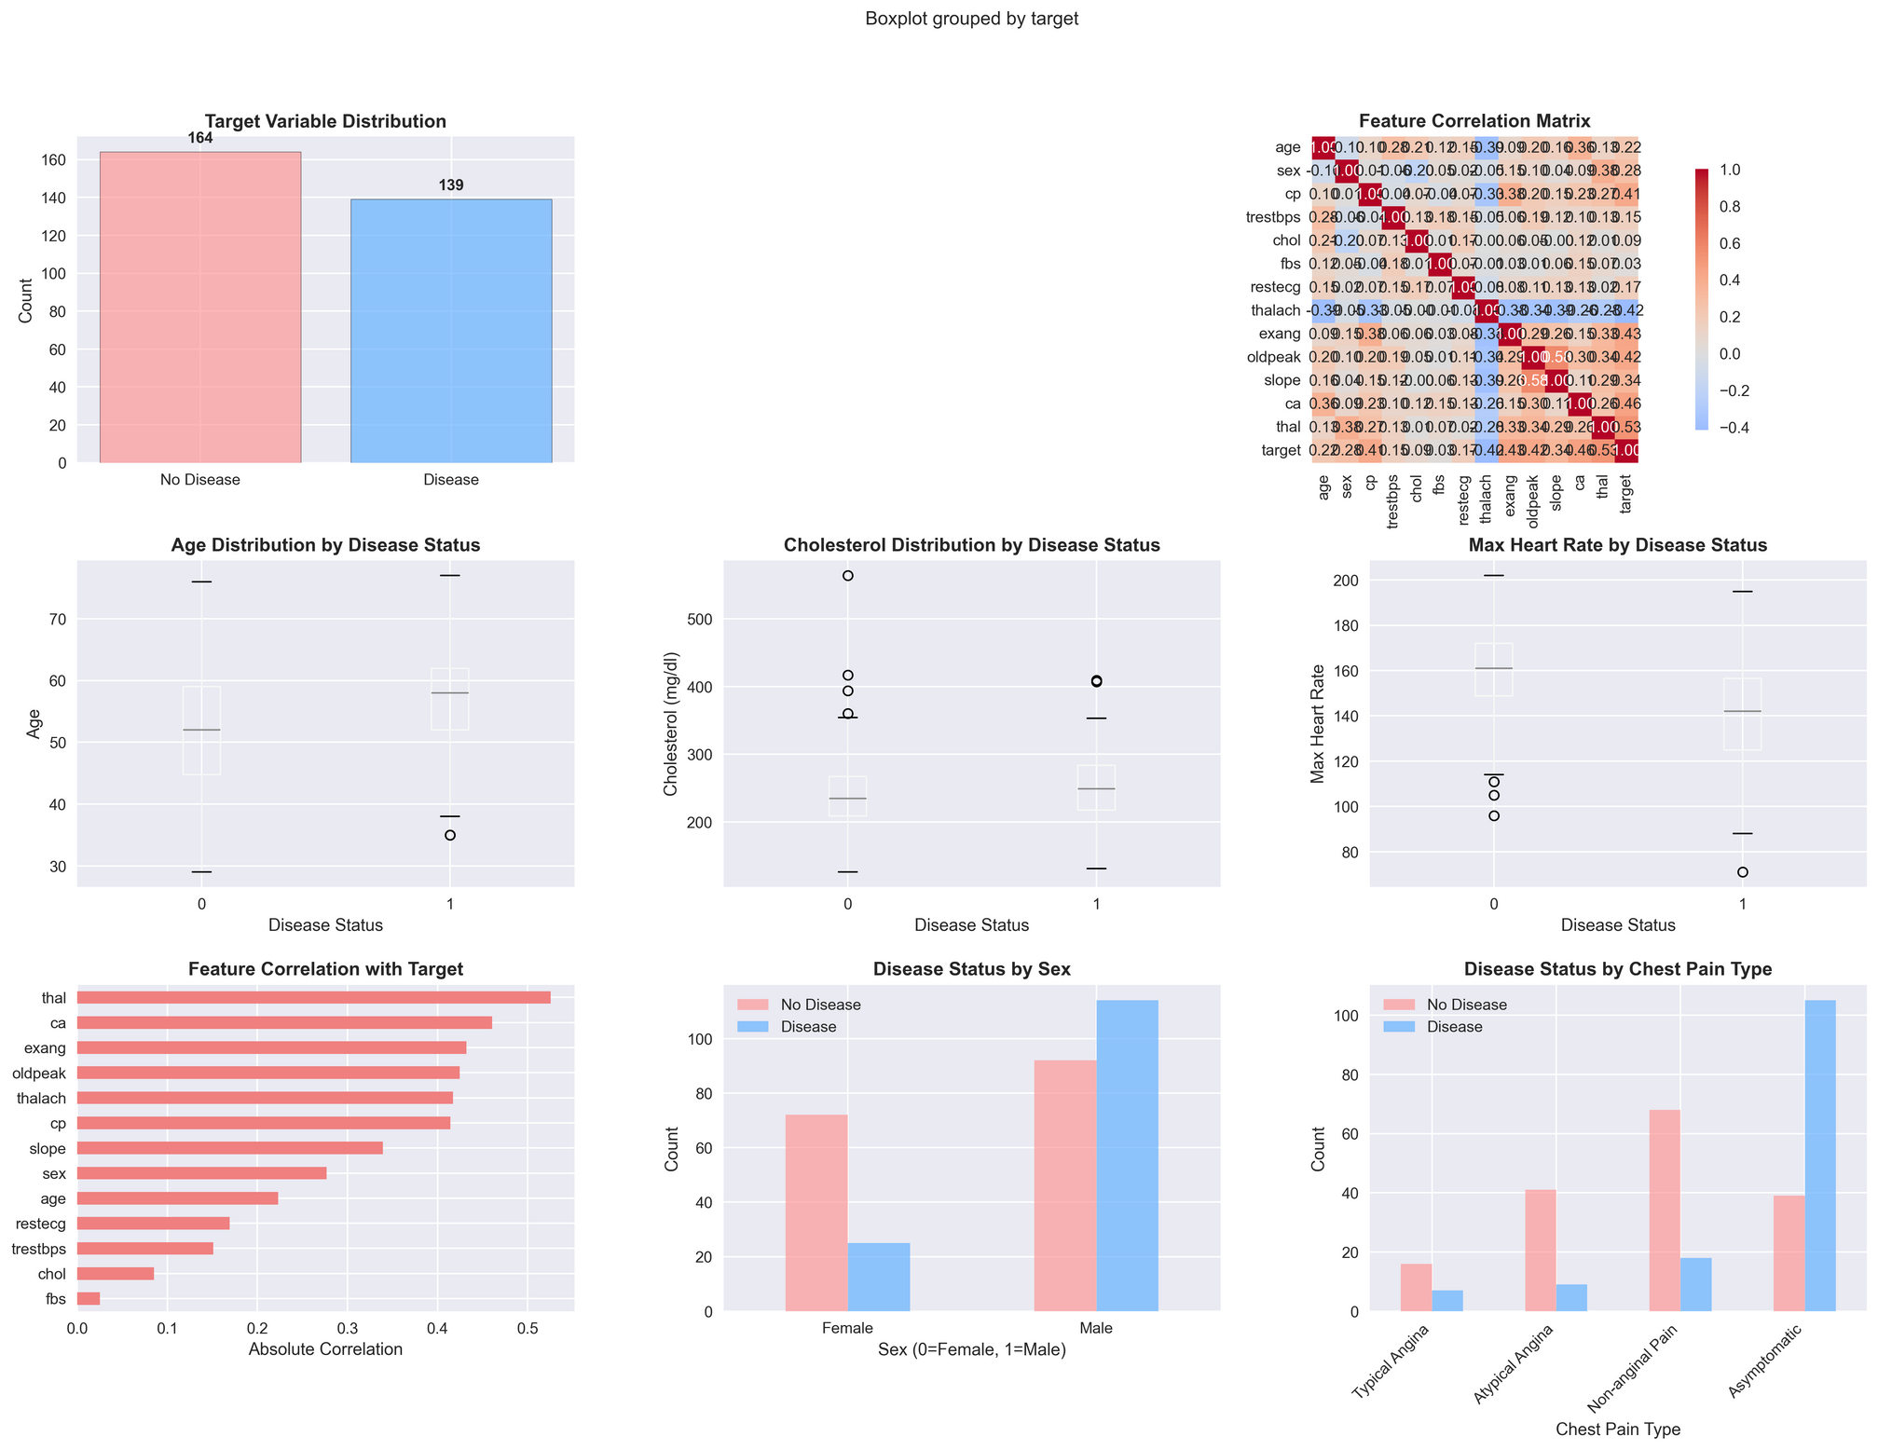
Exploratory Data Analysis Visualization

Slide 7

Data Preprocessing Strategies
Missing Value Handling: Median imputation for robustness to outliers
Feature Scaling: StandardScaler for SVM, ANN, KNN (scale-dependent algorithms)
Class Imbalance: SMOTE applied when ratio < 0.6 (not needed for this dataset)
Train-Test Split: 80/20 with stratification to maintain class distribution
Rationale: Medical data requires careful preprocessing to preserve data quality

Slide 8

Machine Learning Models
Overview of Key Algorithms Used
Random Forest
Support Vector Machine
Logistic Regression
Random Forest is a robust ensemble learning method that excels in accuracy and handles both classification and regression tasks effectively, making it ideal for heart disease prediction.
Support Vector Machines (SVM) are powerful classifiers that work well in high-dimensional spaces, providing great performance in detecting heart disease with clear decision boundaries and flexibility.
Logistic Regression is a fundamental statistical method that is easy to interpret and implement, making it a solid choice for initial heart disease model explorations despite its simplicity.
8

Slide 9


Hyperparameter Tuning Results
Comparing Random Forest and SVM Outcomes
Random Forest
Parameter grid: 108 combinations
Best params: max_depth=5, n_estimators=100
CV score: 0.8344
Test accuracy: 0.9016
Improvement: +1.64% over baseline
SVMs
Parameter grid: 40 combinations
Best params: C=10, gamma=0.001, RBF kernel
CV score: 0.8386
Test accuracy: 0.8525
Better generalization achieved

Slide 10
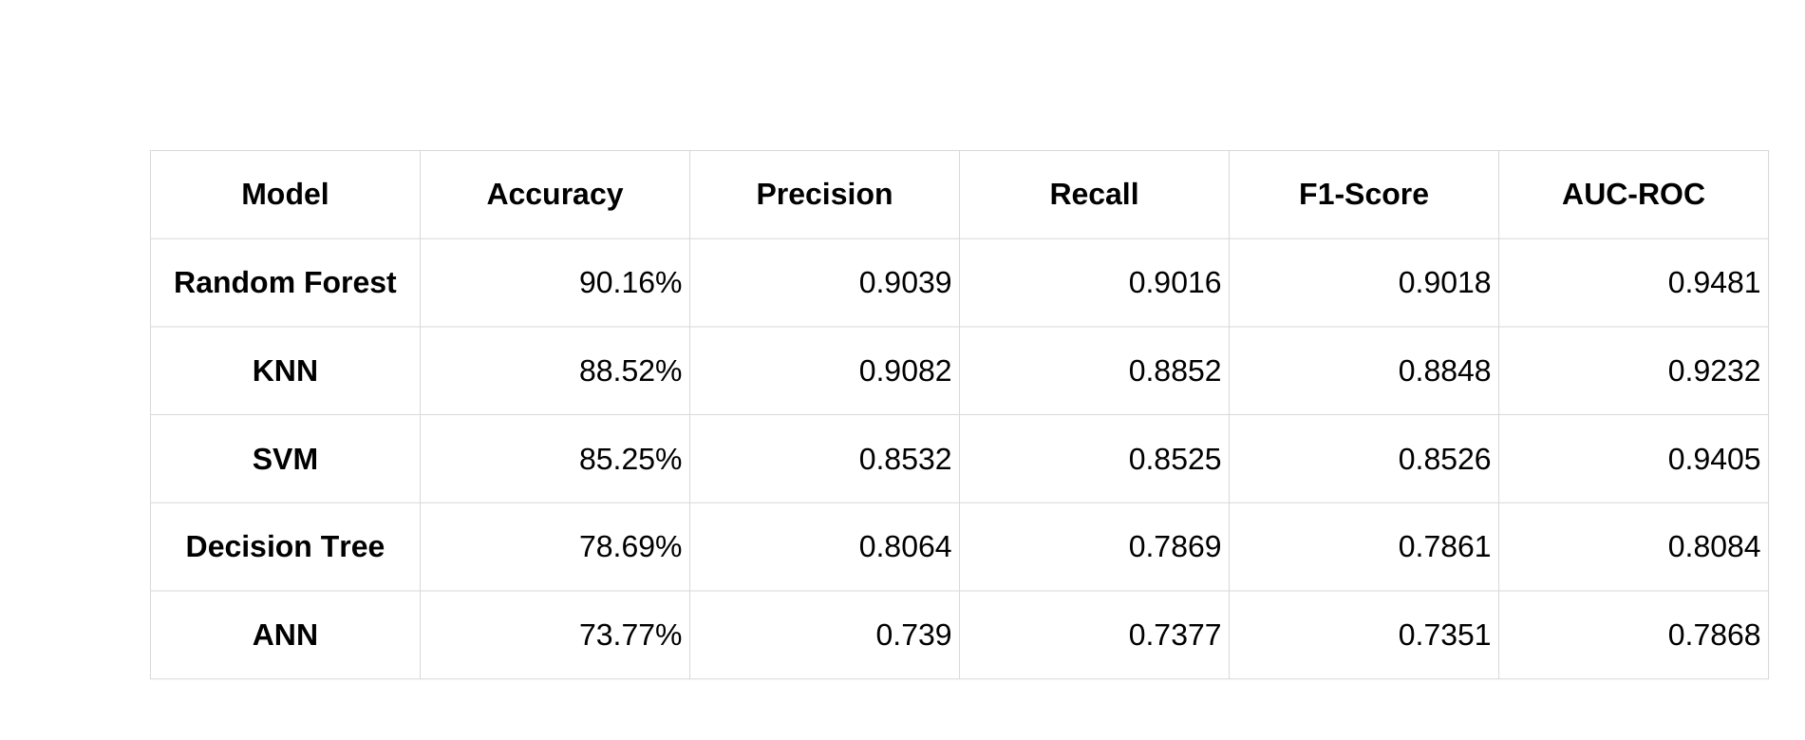
Performance Comparison of Models
Evaluating Accuracy and Effectiveness
10

Slide 11
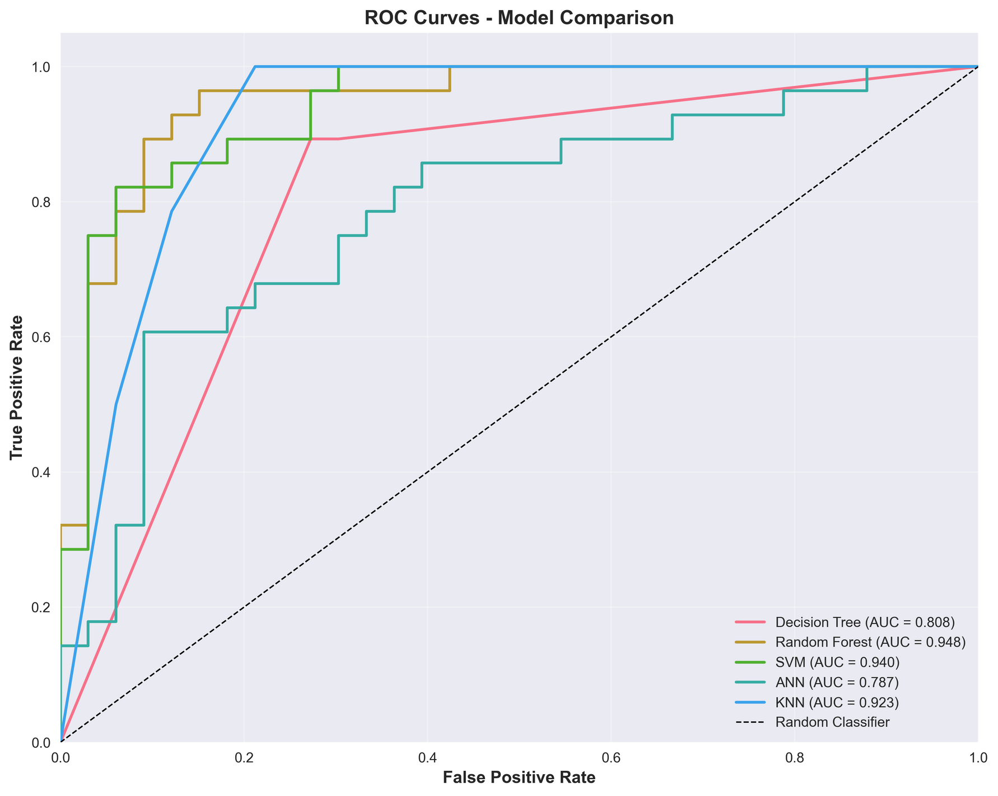
ROC Curves Analysis and Insights
Figure 2: ROC curves comparing all models. Random Forest achieves the highest AUC-ROC of 0.9481.

Slide 12
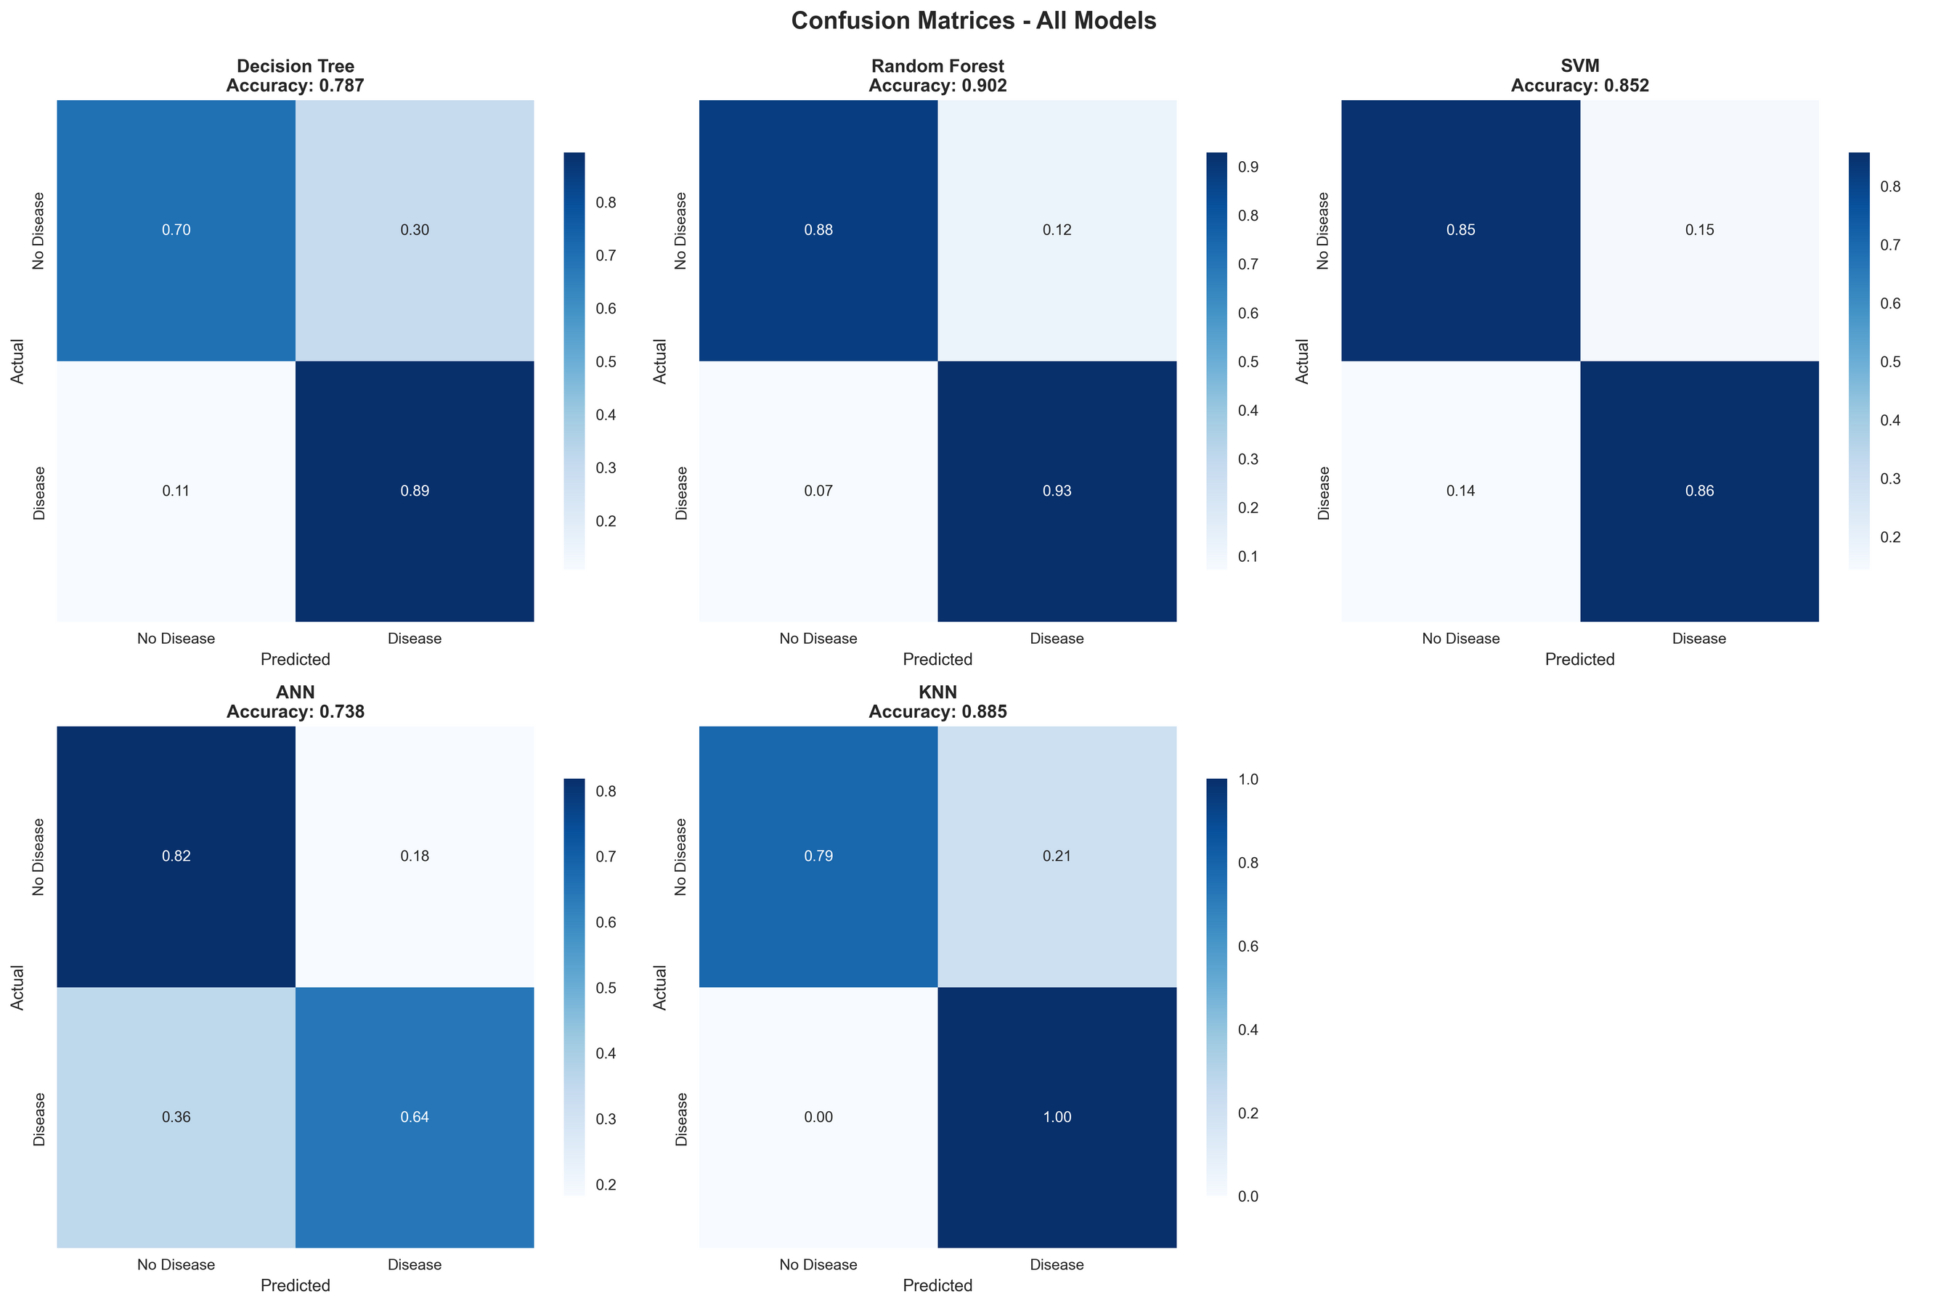
Confusion Matrix Visualization
Figure 3: Normalized confusion matrices for all models showing prediction accuracy breakdown.

Slide 13
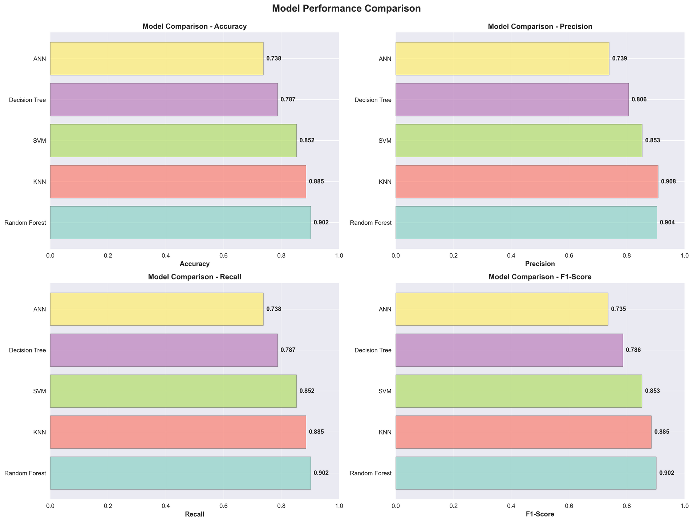
Model Comparison Bar Charts

Slide 14
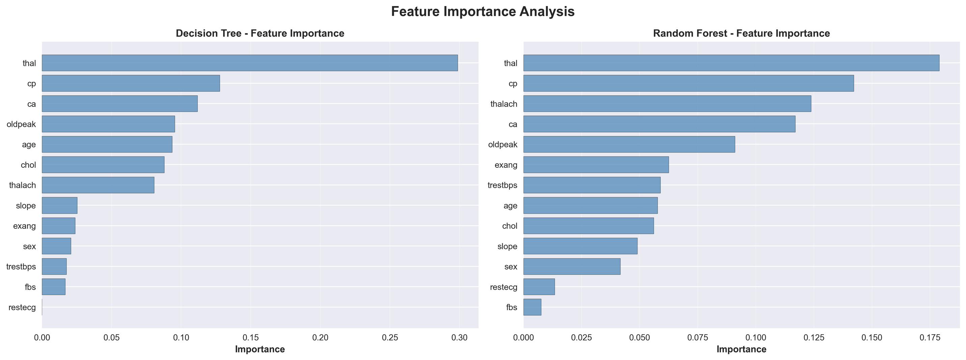
Feature Importance Analysis
Figure 5: Feature importance plots for Decision Tree and Random Forest models showing which clinical features are most predictive.

Slide 15
Learning Curves of ML Models

Slide 16
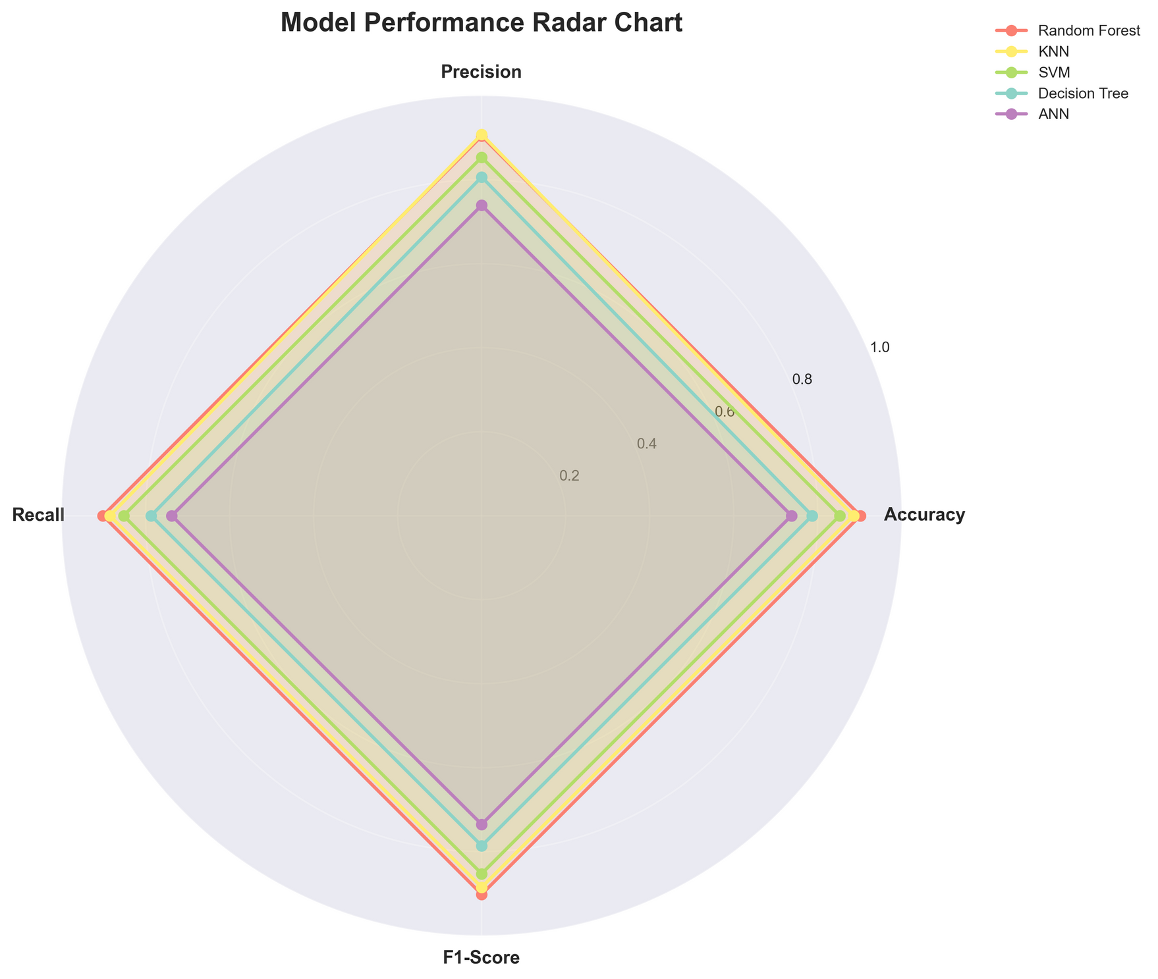
Visualizing Model Performance

Slide 17
Accuracy
90.16%
Best Performing Model: Random Forest
Precision
0.9039
Recognizing the top predictor for heart disease
The Random Forest model has demonstrated outstanding performance in predicting heart disease, achieving high accuracy and reliability metrics, making it a prime candidate for clinical deployment.
Recall
0.9016
Why Random Forest?
Highest performance across all metrics
Excellent balance of precision and recall
Feature importance provides clinical interpretability
Robust generalization (CV score: 0.8344)
Minimal false negatives (critical for medical diagnosis)
F1-Score
0.9018
AUC-ROC
0.9018
17

Slide 18

Key Findings and Insights
All 5 models successfully implemented and evaluated
Hyperparameter tuning improved RF by 1.64% (0.8852 → 0.9016)
Random Forest achieved 90.16% accuracy with balanced metrics
Top features: thalach, oldpeak, ca most predictive
Good generalization without overfitting demonstrated

Slide 19
Limitations and Future Directions
Challenges and pathways for improvement
Limitations
Dataset size: 303 instances relatively small
Single dataset: needs multi-center validation
Limited feature engineering
No external validation dataset
No real-world clinical validation
Future Work
Test on larger, diverse datasets
Advanced feature engineering
Ensemble methods combining models
Explainable AI (SHAP, LIME)
Real-time clinical validation

Slide 20

Recommendations for Clinical Deployment
Deploy Random Forest for clinical decision support
Provide feature importance explanations to clinicians
Implement continuous monitoring of model performance
Conduct external validation before full deployment
Ensure ethical considerations and bias prevention
Maintain human expert oversight as fallback

Slide 21

Summary of Key Takeaways
The research emphasizes the importance of machine learning in heart disease prediction, showcasing significant advancements. Future efforts should focus on clinical integration and ongoing research to enhance predictive accuracy and patient outcomes.
Key Takeaways:
Comparative ML framework essential for medical diagnostics
Random Forest optimal for balancing performance and interpretability
Hyperparameter tuning significantly improves model performance
Feature importance provides clinical insights and trust
Ready for clinical validation and deployment testing

Slide 22
Thank You.
Ali Hamza & Zarmeena Jawad
COMP-240L Machine Learning
Instructor: Dr. Abid Ali

